Slide 1
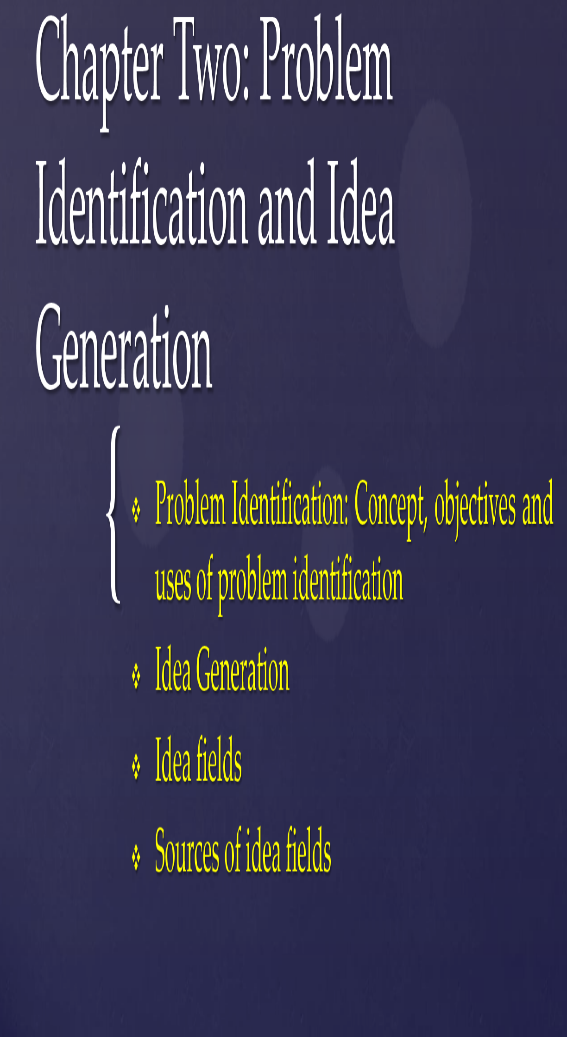

Slide 2


Slide 3
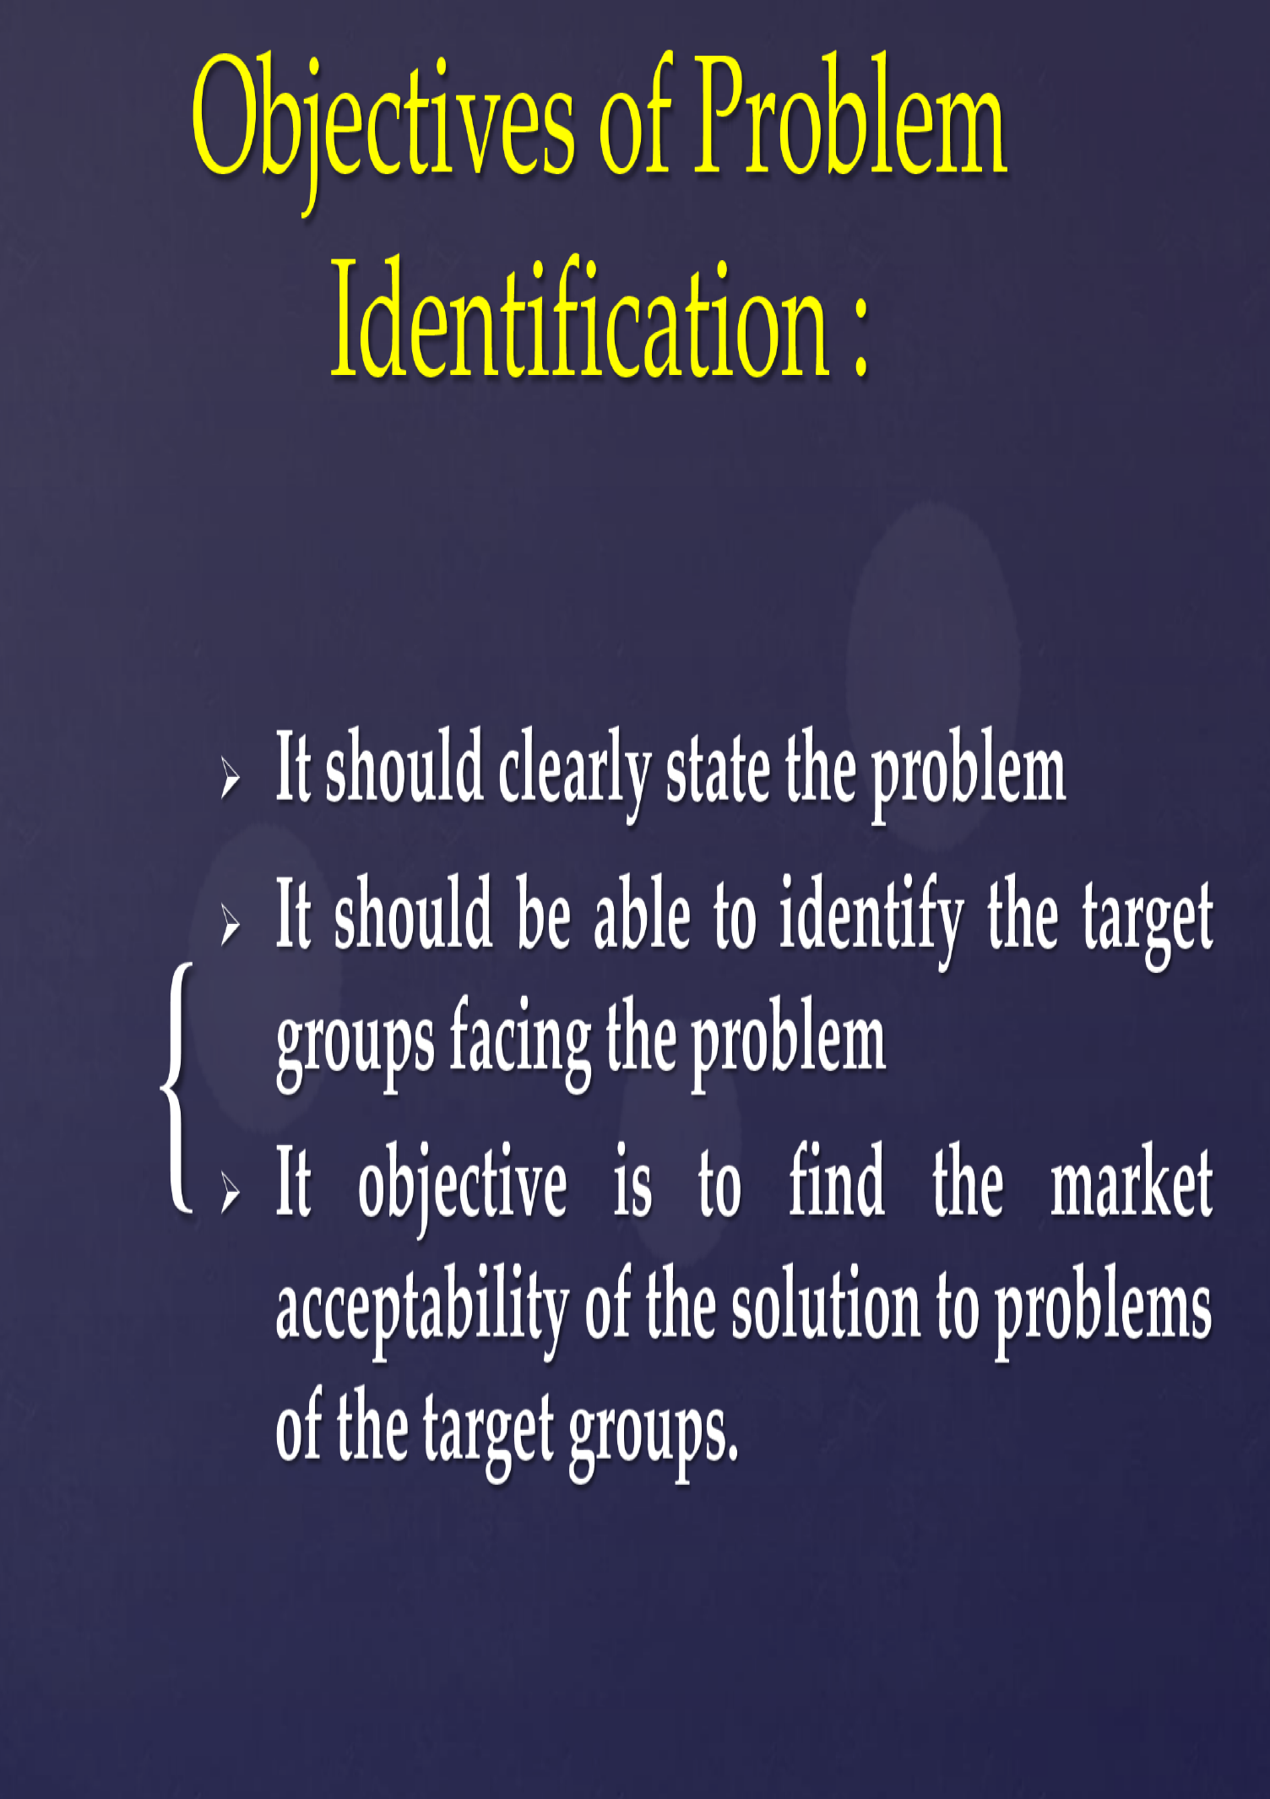

Slide 4
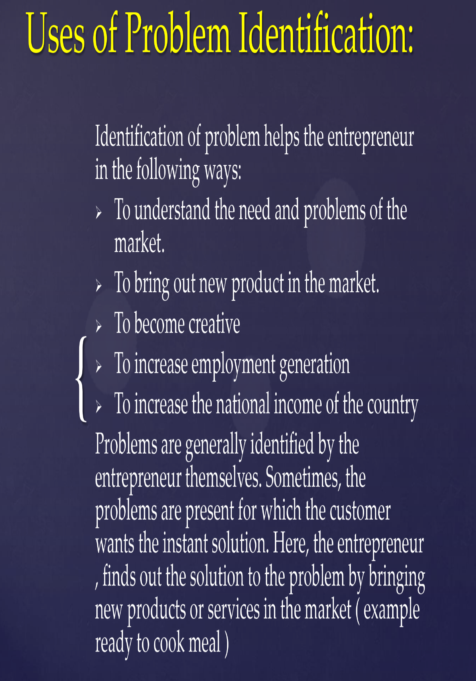

Slide 5
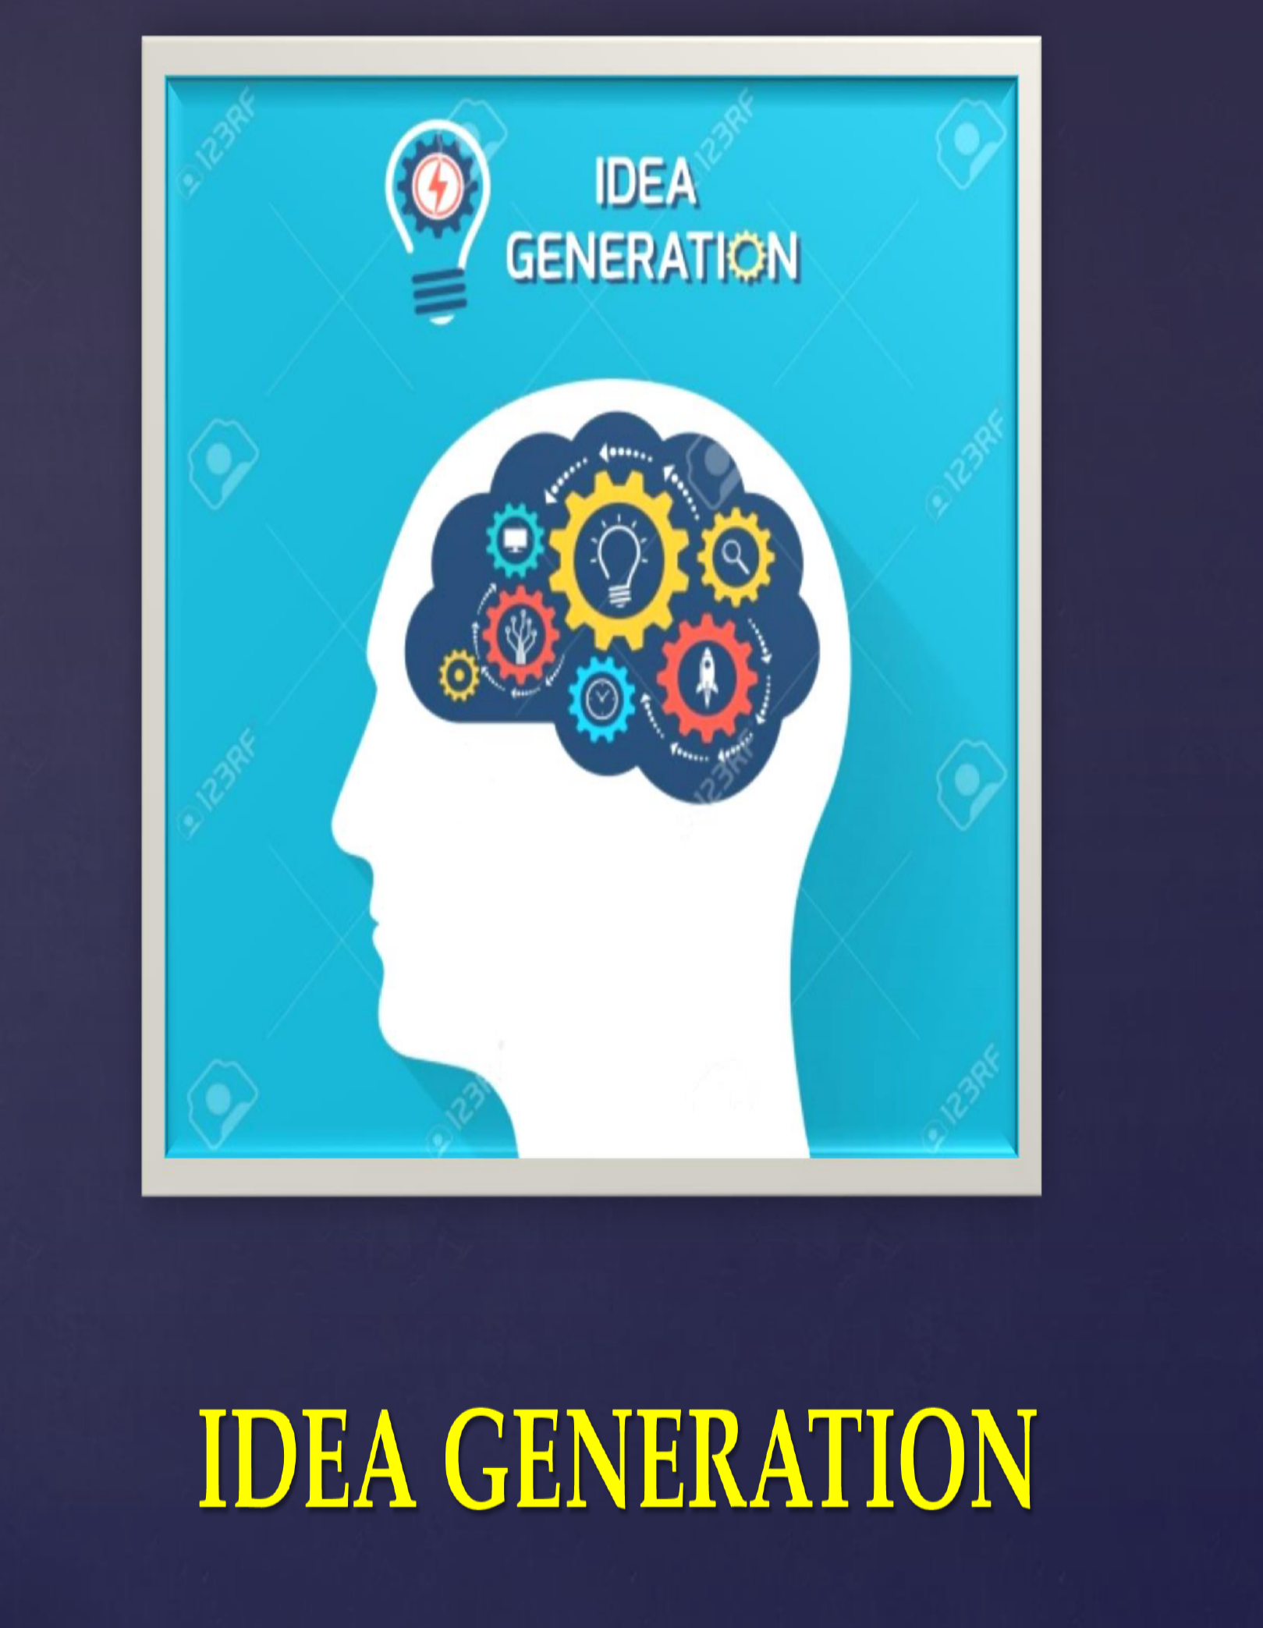

Slide 6
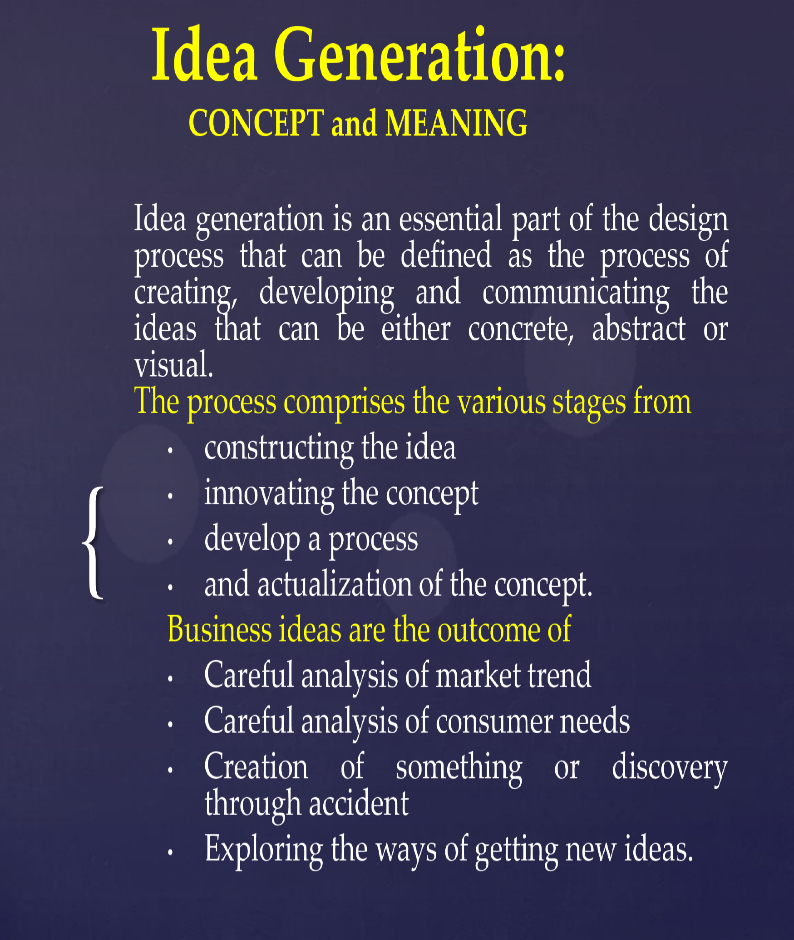

Slide 7
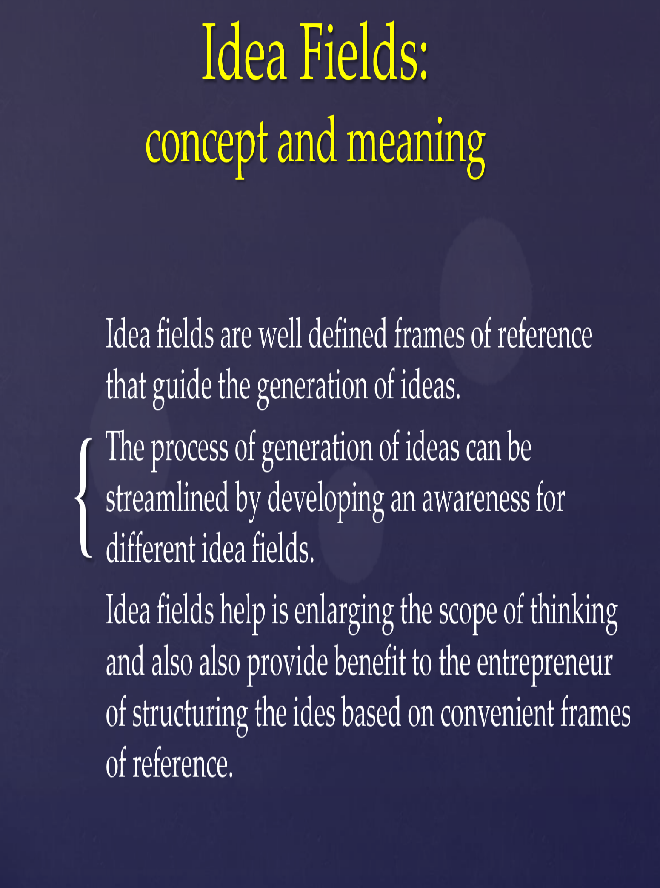

Slide 8
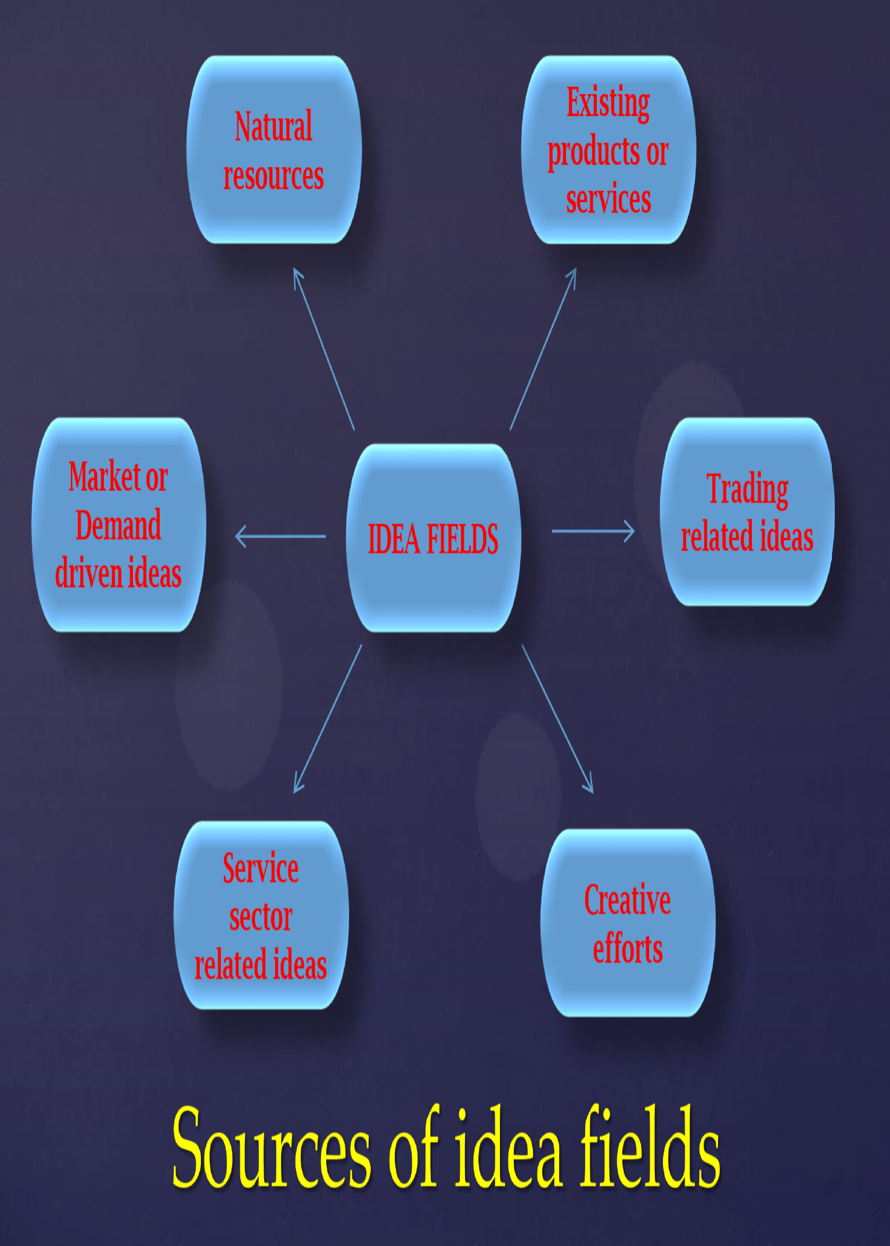

Slide 9


Slide 10
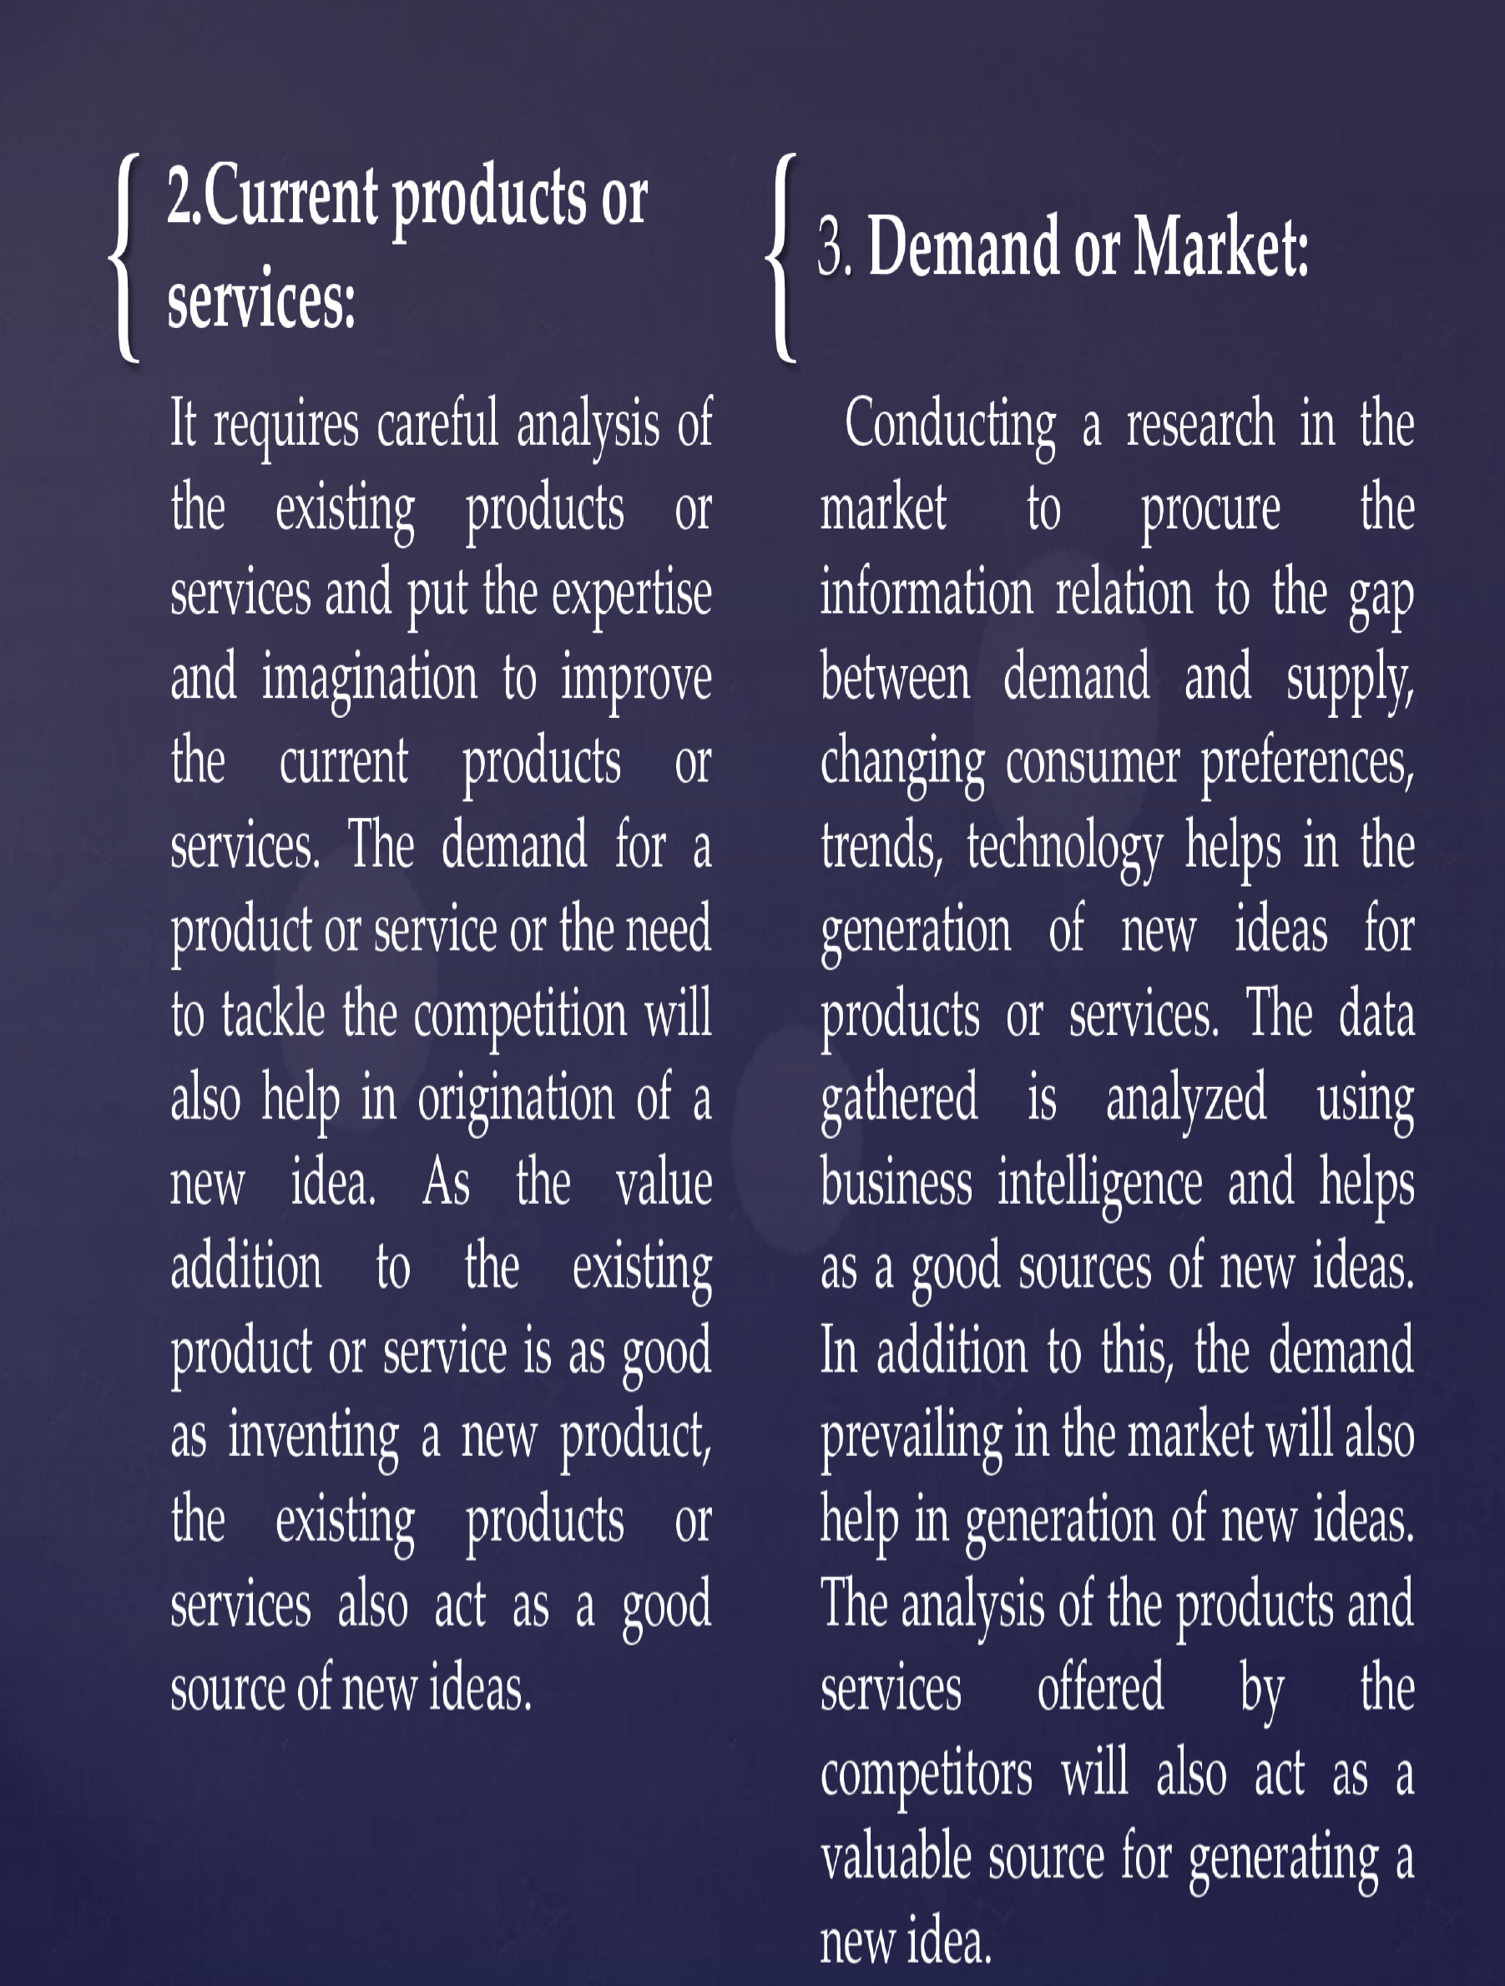

Slide 11


Slide 12
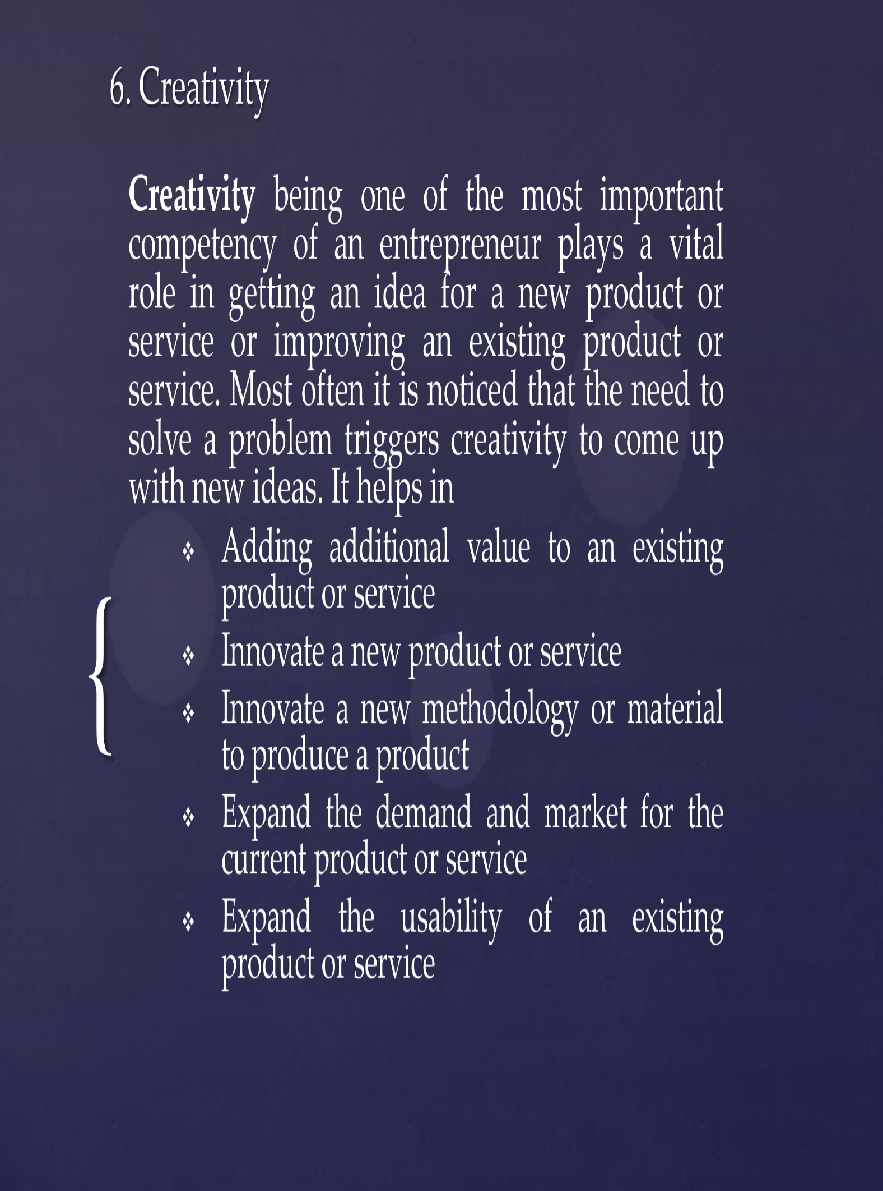

Slide 13
Identifying your customer segments and early adopters is a crucial step in developing a successful business or launching a new product or service.
1. Define Your Target Market:
Start by defining the characteristics of the market you intend to serve. Consider demographics (age, gender, income), psychographics (lifestyle, values, interests), and geographic location.
2. Conduct Market Research:
Use surveys, interviews, and secondary research to gather data about potential customers. This can include information about their needs, pain points, and preferences.
3. Segment Your Market:
Divide your target market into distinct segments based on common characteristics and needs. Segmentation can be done using criteria like demographics, behaviour, and psychographics. For example, you might have segments like "young professionals," "stay-at-home parents," or "small business owners."

Slide 14
4. Create Customer Personas:
Develop detailed customer personas for each segment. These are fictional representations of your ideal customers within each segment, including their names, ages, job titles, goals, and challenges.
5. Identify Early Adopters:
Early adopters are the customers most likely to embrace your product or service first. Look for characteristics like:
Innovative mindset: Early adopters are open to trying new things and embracing innovation.
Problem solvers: They actively seek solutions to their problems or pain points.
Readiness to take risks: Early adopters are willing to take a chance on new products or services.
Strong influence: They often have a network of followers or peers who trust their recommendations.
6. Validate Your Assumptions:
Test your customer segments and early adopter assumptions through market research, surveys, or pilot programs. Collect feedback and adjust your strategies based on the results.

Slide 15
7. Refine Your Marketing Strategy:
Tailor your marketing efforts to target each customer segment effectively. Craft messaging, channels, and offers that resonate with their specific needs and preferences.
8. Launch and Monitor:
Launch your product or service with a focused approach targeting early adopters and the identified customer segments. Continuously monitor and gather data on customer behaviour and feedback.
9. Expand to Other Segments:
Once you've gained traction with early adopters, gradually expand your marketing efforts to reach broader customer segments. Use the insights gained from early adopters to refine your offering.
10. Iterate and Evolve: - Be prepared to iterate and adapt your strategies as you gather more data and insights. Customer preferences and market dynamics can change over time.
Notes:
Remember that identifying customer segments and early adopters is an ongoing process. As your business evolves and grows, your understanding of your customers may also change, and you may need to refine your segmentation and targeting strategies accordingly.

Slide 16
Scenario 1: Health and Fitness App
Customer Segments:
Fitness Enthusiasts: People who are actively engaged in fitness routines, such as gym-goers and runners.
Weight Loss Seekers: Individuals looking to lose weight or maintain a healthy lifestyle through diet and exercise.
Seniors for Wellness: Older adults looking to stay active and healthy through low-impact exercises and wellness tips.
Early Adopters:
The early adopters in this case might be fitness trainers, wellness bloggers, or individuals who have a strong presence on social media and are eager to try out new fitness apps to share with their followers.

Slide 17
Scenario 2: Software as a Service (SaaS) Project Management Tool
Customer Segments:
Startups and Small Businesses: These companies might be looking for cost-effective project management solutions to streamline their operations.
Enterprise-Level Businesses: Larger corporations with complex project management needs.
Freelancers and Independent Contractors: Individuals who work on various projects and require efficient project management tools.
Early Adopters:
Early adopters for this SaaS product might include tech-savvy project managers or teams within startups who are open to trying new tools to improve their workflow. They may be active in online communities discussing project management software.

